Slide 1
Lesson 20
Tuning the PL/SQL Compiler

Slide 2

Objectives
After completing this lesson, you should be able to:
  Use the PL/SQL compiler initialization parameters
  Use the PL/SQL compile-time warnings

Slide 3

Lesson Agenda
  Using PL/SQL initialization parameters
  Using the PL/SQL compile-time warnings:
    Using the PLSQL_WARNING initialization parameter
    Using the DBMS_WARNING package subprograms

Slide 4

Optimizing PL/SQL Compiler Performance
  The PL/SQL compiler implicitly rearranges the code for better performance.
  The compiler behavior is defined by its initialization parameters.
  You can use initialization parameters to tune the performance of the compiler according to the application requirement.

Slide 5
Initialization Parameters for PL/SQL Compilation
Compilation Parameter | Description
PLSCOPE_SETTINGS | Controls the compile-time collection, cross-reference, and storage of the PL/SQL source text identifier data
PLSQL_CCFLAGS | Lets you control conditional compilation of each PL/SQL unit independently
PLSQL_CODE_TYPE | Specifies the compilation mode for PL/SQL units - INTERPRETED (the default) or NATIVE
PLSQL_OPTIMIZE_LEVEL | Specifies the optimization level at which to compile PL/SQL units
PLSQL_WARNINGS | Enables or disables the reporting of warning messages by the PL/SQL compiler, and specifies which warning messages to show as errors
NLS_LENGTH_SEMANTICS | Lets you create CHAR and VARCHAR2 columns by using either byte-length or character-length semantics

Slide 6
Using the Initialization Parameters for PL/SQL Compilation
  PLSQL_CODE_TYPE: Specifies the compilation mode for PL/SQL library units
  PLSQL_CODE_TYPE = { INTERPRETED | NATIVE }
  PLSQL_OPTIMIZE_LEVEL: Specifies the optimization level to be used to compile PL/SQL library units
  PLSQL_OPTIMIZE_LEVEL = { 0 | 1 | 2 | 3}

Slide 7
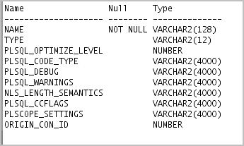
Displaying the PL/SQL Initialization Parameters
Use the USER|ALL|DBA_PLSQL_OBJECT_SETTINGS data dictionary views to display the settings for a PL/SQL object:
  DESCRIBE USER_PLSQL_OBJECT_SETTINGS;

Slide 8

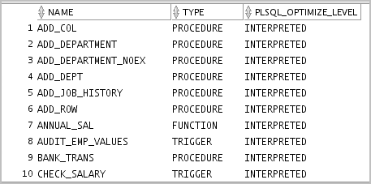
Displaying and Setting PL/SQL Initialization Parameters
SELECT name, type, plsql_code_type,
plsql_optimize_level
FROM user_plsql_object_settings;
  Set the compiler initialization parameter’s value by using the ALTER SYSTEM or ALTER SESSION statements.
  The parameters’ values are accessed when the CREATE OR REPLACE statement is executed.

Slide 9


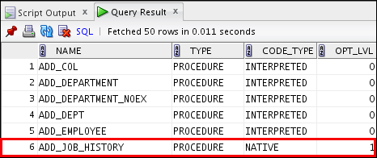
Changing PL/SQL Initialization Parameters: Example
ALTER SESSION SET PLSQL_OPTIMIZE_LEVEL = 1;
ALTER SESSION SET PLSQL_CODE_TYPE = 'NATIVE';
-- code displayed in the notes page
CREATE OR REPLACE PROCEDURE add_job_history
. . .
@code_11_09_sa.sql

Slide 10
Lesson Agenda
  Using PL/SQL initialization parameters
  Using the PL/SQL compile-time warnings:
    Using the PLSQL_WARNING initialization parameter
    Using the DBMS_WARNING package subprograms

Slide 11

PL/SQL Compile-Time Warnings
  Messages from compiler that help in improving code maintainability
  Developers can use them to reduce the chances of bugs creeping in to the application.
  A PL/SQL unit flagged with warnings may execute successfully, but might exhibit unexpected behavior or inefficient performance.
  All PL/SQL warning messages use the prefix PLW.

Slide 12
Benefits of Compiler Warnings
  Make programs more robust and avoid problems at run time
  Identify potential performance problems
  Identify factors that produce undefined results

Slide 13



Categories of PL/SQL Compile-Time Warning Messages
SEVERE
PERFORMANCE
INFORMATIONAL
  Condition might cause unexpected action or wrong results.
  Condition does not affect performance or correctness, but you might want to change it for better maintainability.
  Condition might cause performance problems.

Slide 14
Enabling Warning Messages
You can enable displaying warning messages by using one of the following methods:
  The PLSQL_WARNINGS initialization parameter
  The DBMS_WARNING package

Slide 15



Setting Compiler Warning Levels: Using PLSQL_WARNINGS, Examples
ALTER SESSION
SET plsql_warnings = 'enable:severe',
'enable:performance', 'disable:informational';
ALTER SESSION
SET plsql_warnings = 'enable:severe';
ALTER SESSION SET PLSQL_WARNINGS='ENABLE:SEVERE',
'DISABLE:PERFORMANCE' , 'ERROR:05003';

Slide 16
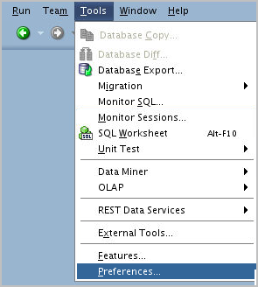
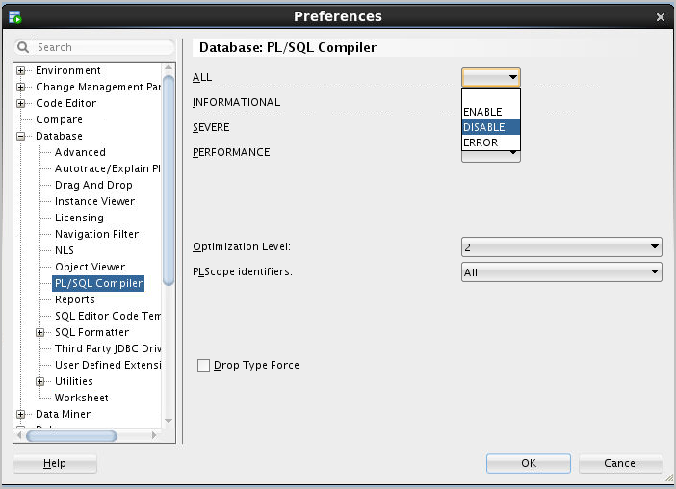
Enabling Compiler Warnings:
Using PLSQL_WARNINGS in SQL Developer

Slide 17

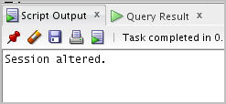
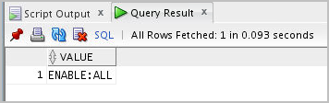
Viewing the Current Setting of PLSQL_WARNINGS
  You can examine the current setting for the PLSQL_WARNINGS parameter by issuing a SELECT statement on the V$PARAMETER view.
        ALTER SESSION SET plsql_warnings = 'enable:severe', 'enable:performance','enable:informational';
        /
        SELECT value FROM v$parameter WHERE name='plsql_warnings';
/

Slide 18
Viewing Compiler Warnings
  You can view compiler warnings through:
    SQL*Plus with SHOW ERRORS command
    Data Dictionary views

Slide 19

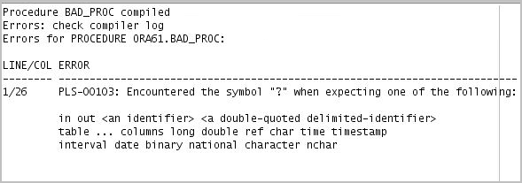
SQL*Plus Warning Messages: Example
CREATE OR REPLACE PROCEDURE bad_proc(p_out …) IS
BEGIN
. . .;
END;
/
SP2-0804: Procedure created with compilation warnings.

Slide 20
Defining PLSQL_WARNINGS for Program Units
  The settings for the PLSQL_WARNINGS parameter are stored along with each compiled subprogram.
  If you recompile the subprogram using one of the following statements, the current settings for that session are used:
    CREATE OR REPLACE
    ALTER ... COMPILE
  If you recompile the subprogram using the ALTER ... COMPILE statement with the REUSE SETTINGS clause, the original setting stored with the program is used.

Slide 21
Lesson Agenda
  Using the PL/SQL initialization parameters
  Using the PL/SQL compile-time warnings:
    Using the PLSQL_WARNING initialization parameter
    Using the DBMS_WARNING package subprograms
2
Unique key column
Unique key column
Unique key column
Unique key column

Slide 22
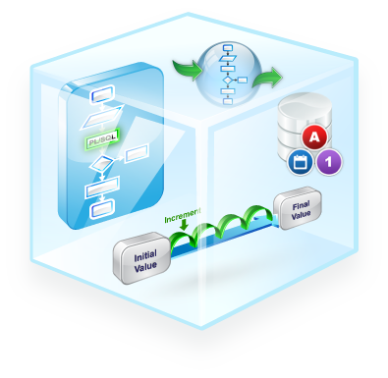
Using the DBMS_WARNINGS Package
You can use the DBMS_WARNINGS package to:
  Manipulate the behavior of PL/SQL warning messages
  Change the definition of PLSQL_WARNINGS parameter
  Query, modify, and delete current system or session settings

Slide 23
Using the DBMS_WARNING Package Subprograms
Scenario | Subprograms to Use
Set warnings | ADD_WARNING_SETTING_CAT (procedure) ADD_WARNING_SETTING_NUM (procedure)
Query warnings | GET_WARNING_SETTING_CAT (function) GET_WARNING_SETTING_NUM (function) GET_WARNING_SETTING_STRING (function)
Replace warnings | SET_WARNING_SETTING_STRING (procedure)
Get the warnings’ categories names | GET_CATEGORY (function)

Slide 24



The DBMS_WARNING Procedures:
Syntax, Parameters, and Allowed Values
EXECUTE DBMS_WARNING.ADD_WARNING_SETTING_CAT (-
warning_category IN VARCHAR2,
warning_value IN VARCHAR2,
scope IN VARCAHR2);
EXECUTE DBMS_WARNING.ADD_WARNING_SETTING_NUM (-
warning_number IN NUMBER,
warning_value IN VARCHAR2,
scope IN VARCAHR2);
EXECUTE DBMS_WARNING.SET_WARNING_SETTING_STRING (-
warning_value IN VARCHAR2,
scope IN VARCHAR2);

Slide 25

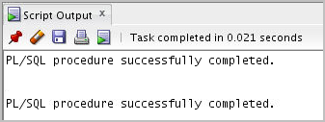
The DBMS_WARNING Procedures: Example
-- Establish the following warning setting string in the
-- current session:
-- ENABLE:INFORMATIONAL,
-- DISABLE:PERFORMANCE,
-- ENABLE:SEVERE
EXECUTE DBMS_WARNING.SET_WARNING_SETTING_STRING(-
'ENABLE:ALL', 'SESSION');
EXECUTE DBMS_WARNING.ADD_WARNING_SETTING_CAT(-
'PERFORMANCE','DISABLE', 'SESSION');

Slide 26
The DBMS_WARNING Functions:
Syntax, Parameters, and Allowed Values
DBMS_WARNING.GET_WARNING_SETTING_CAT (-
warning_category IN VARCHAR2) RETURN warning_value;
DBMS_WARNING.GET_WARNING_SETTING_NUM (-
warning_number IN NUMBER) RETURN warning_value;
DBMS_WARNING.GET_WARNING_SETTING_STRING
RETURN pls_integer;
DBMS_WARNING.GET_CATEGORY (-
warning_number IN pls_integer) RETURN VARCHAR2;

Slide 27




The DBMS_WARNING Functions: Example
-- Determine the current session warning settings
SET SERVEROUTPUT ON
EXECUTE DBMS_OUTPUT.PUT_LINE( -
DBMS_WARNING.GET_WARNING_SETTING_STRING);
-- Determine the category for warning message number
-- PLW-07203
SET SERVEROUTPUT ON
EXECUTE DBMS_OUTPUT.PUT_LINE( -
DBMS_WARNING.GET_CATEGORY(7203));

Slide 28

Using DBMS_WARNING: Example
CREATE OR REPLACE PROCEDURE compile_code(p_pkg_name VARCHAR2) IS
v_warn_value VARCHAR2(200);
v_compile_stmt VARCHAR2(200) :=
'ALTER PACKAGE '|| p_pkg_name ||' COMPILE';
BEGIN
v_warn_value := DBMS_WARNING.GET_WARNING_SETTING_STRING;
DBMS_OUTPUT.PUT_LINE('Current warning settings: '||
v_warn_value);
DBMS_WARNING.ADD_WARNING_SETTING_CAT(
'PERFORMANCE', 'DISABLE', 'SESSION');
DBMS_OUTPUT.PUT_LINE('Modified warning settings: '||
DBMS_WARNING.GET_WARNING_SETTING_STRING);
EXECUTE IMMEDIATE v_compile_stmt;
DBMS_WARNING.SET_WARNING_SETTING_STRING(v_warn_value,
'SESSION');
DBMS_OUTPUT.PUT_LINE('Restored warning settings: '||
DBMS_WARNING.GET_WARNING_SETTING_STRING);
END;
/

Slide 29


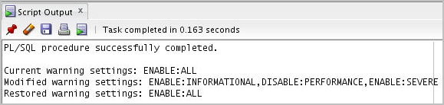
Using DBMS_WARNING: Example
EXECUTE DBMS_WARNING.SET_WARNING_SETTING_STRING(-
'ENABLE:ALL', 'SESSION');
@/home/oracle/labs/plpu/code_ex/code_ex_scripts/code_12_33_s.sql
EXECUTE compile_code('EMP_PKG');

Slide 30

Quiz
The categories of PL/SQL compile-time warning messages are:
  SEVERE
  PERFORMANCE
  INFORMATIONAL
  All
  CRITICAL

Slide 31

Summary
In this lesson, you should have learned how to:
  Use the PL/SQL compiler initialization parameters
  Use the PL/SQL compile-time warnings

